Slide 1
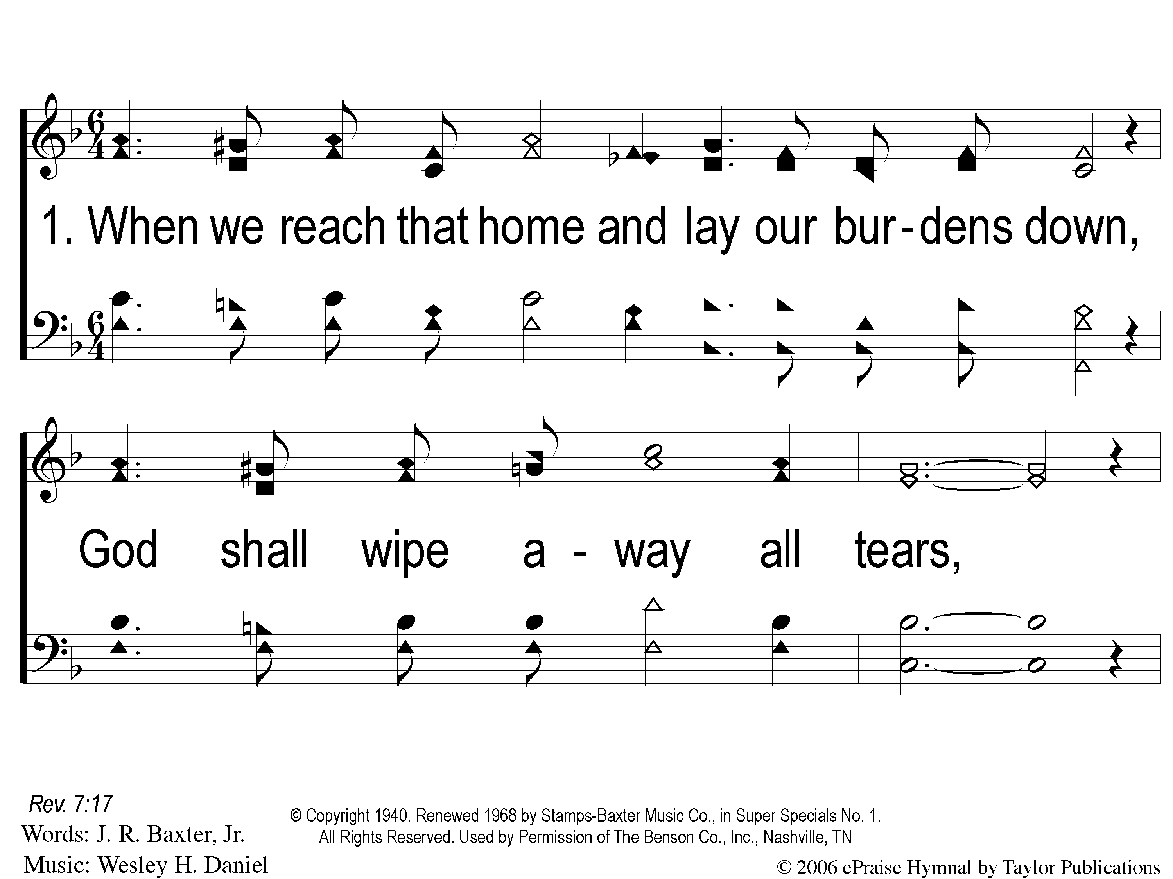
1-1 God Shall Wipe Away
God Shall Wipe Away
136

Slide 2
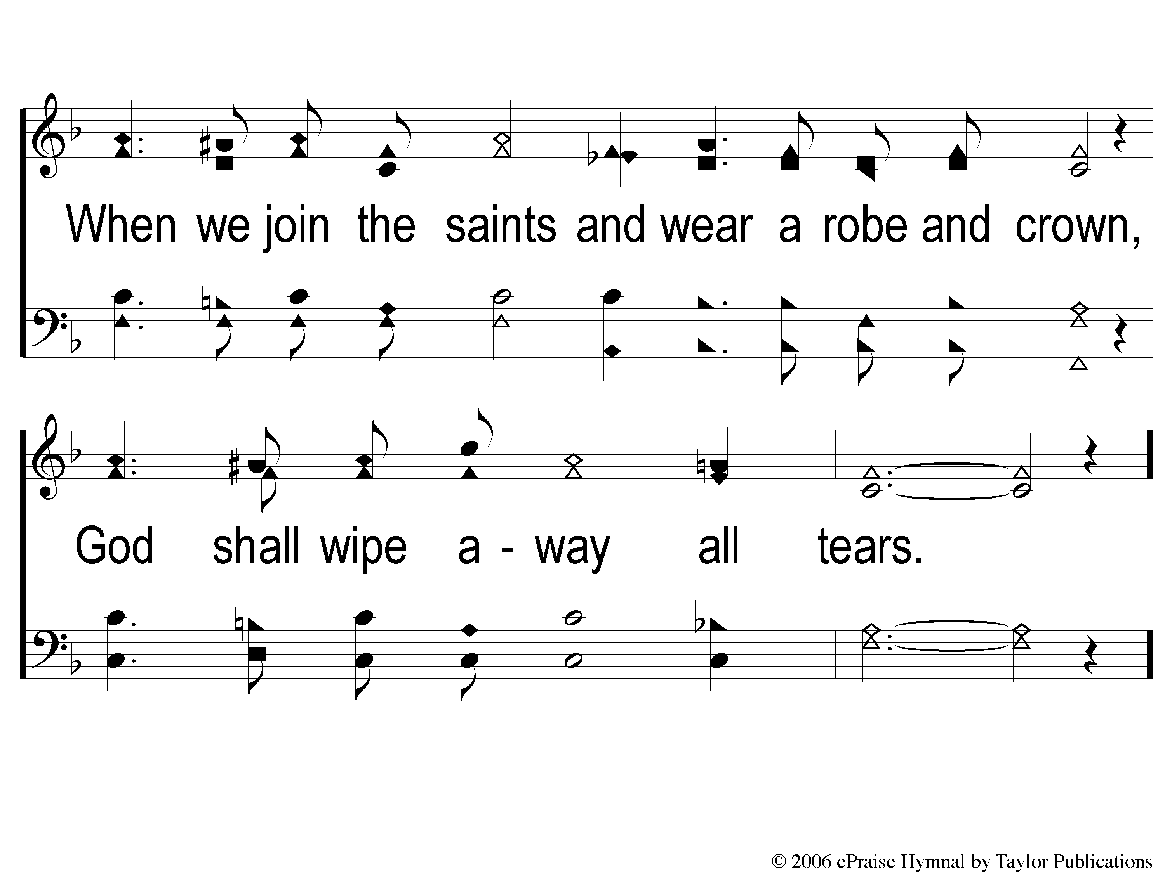
1-2 God Shall Wipe Away
God Shall Wipe Away
136

Slide 3
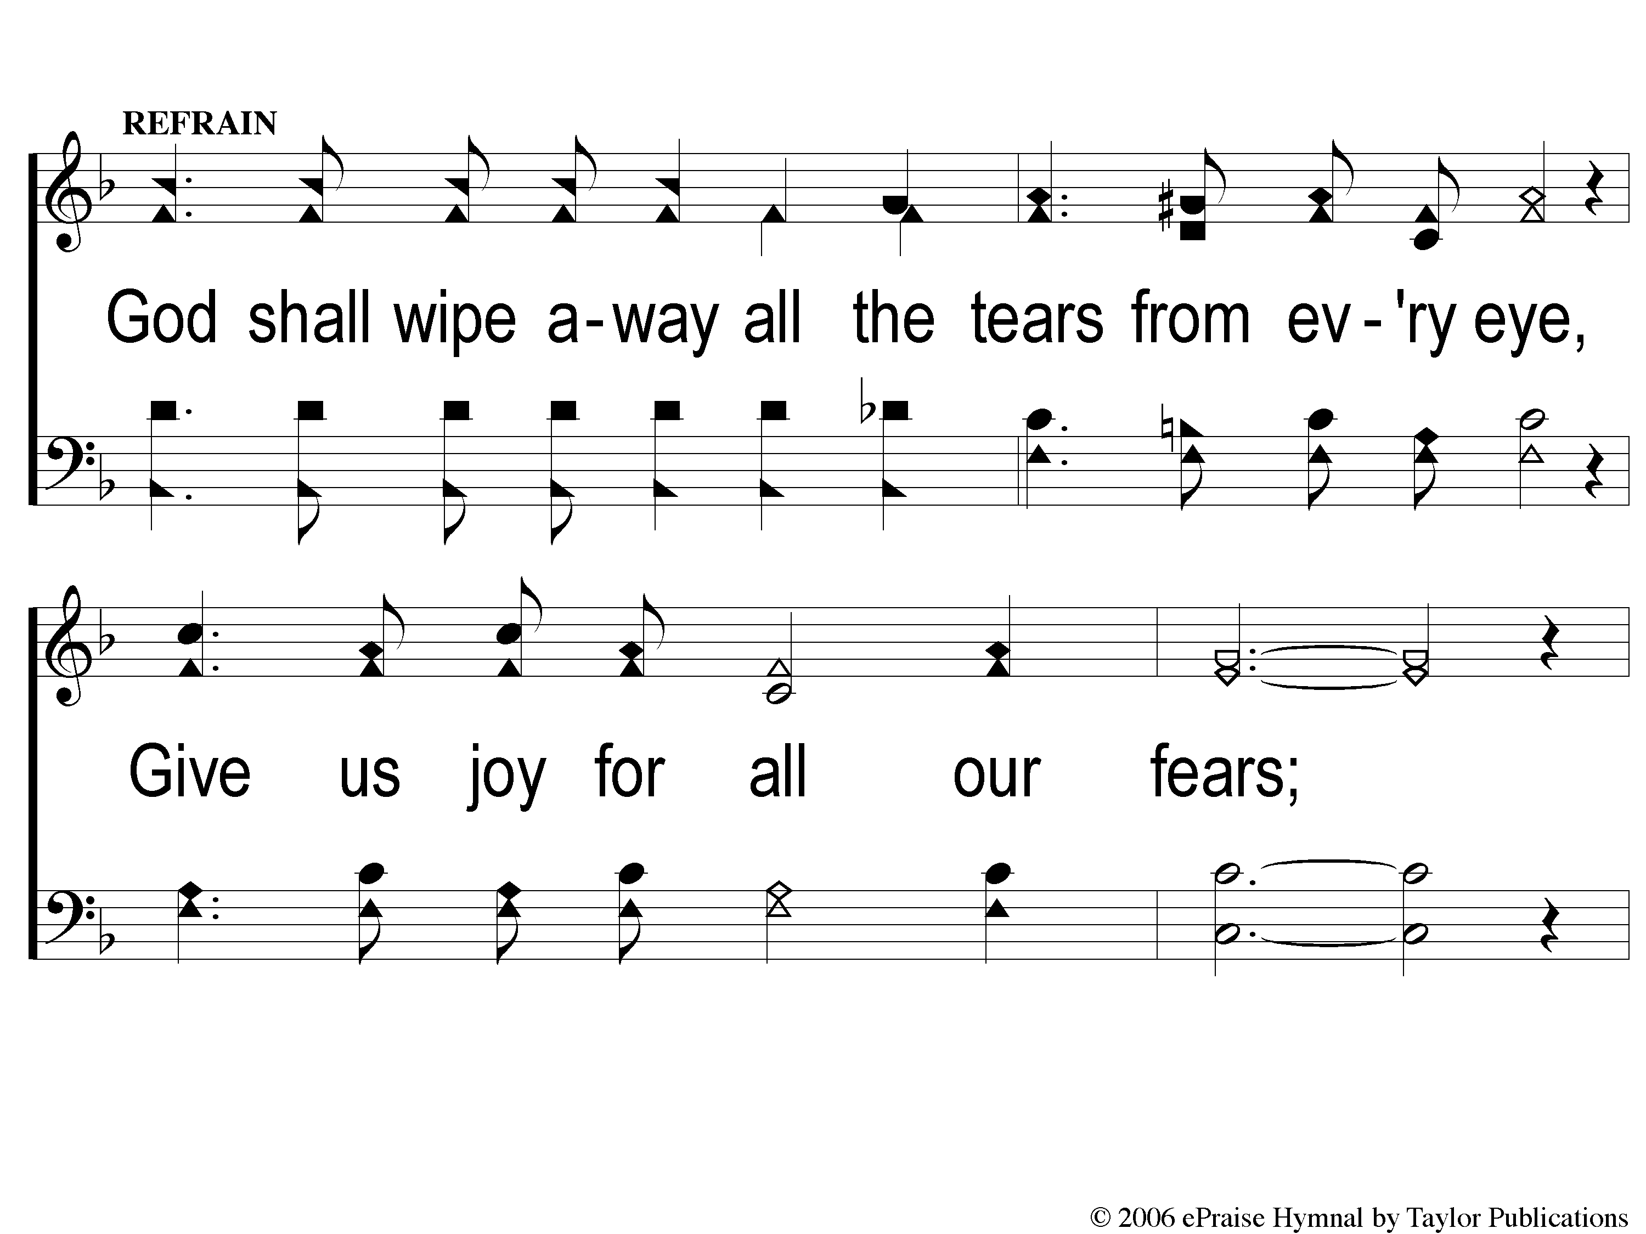
C-1 God Shall Wipe Away
God Shall Wipe Away
136

Slide 4
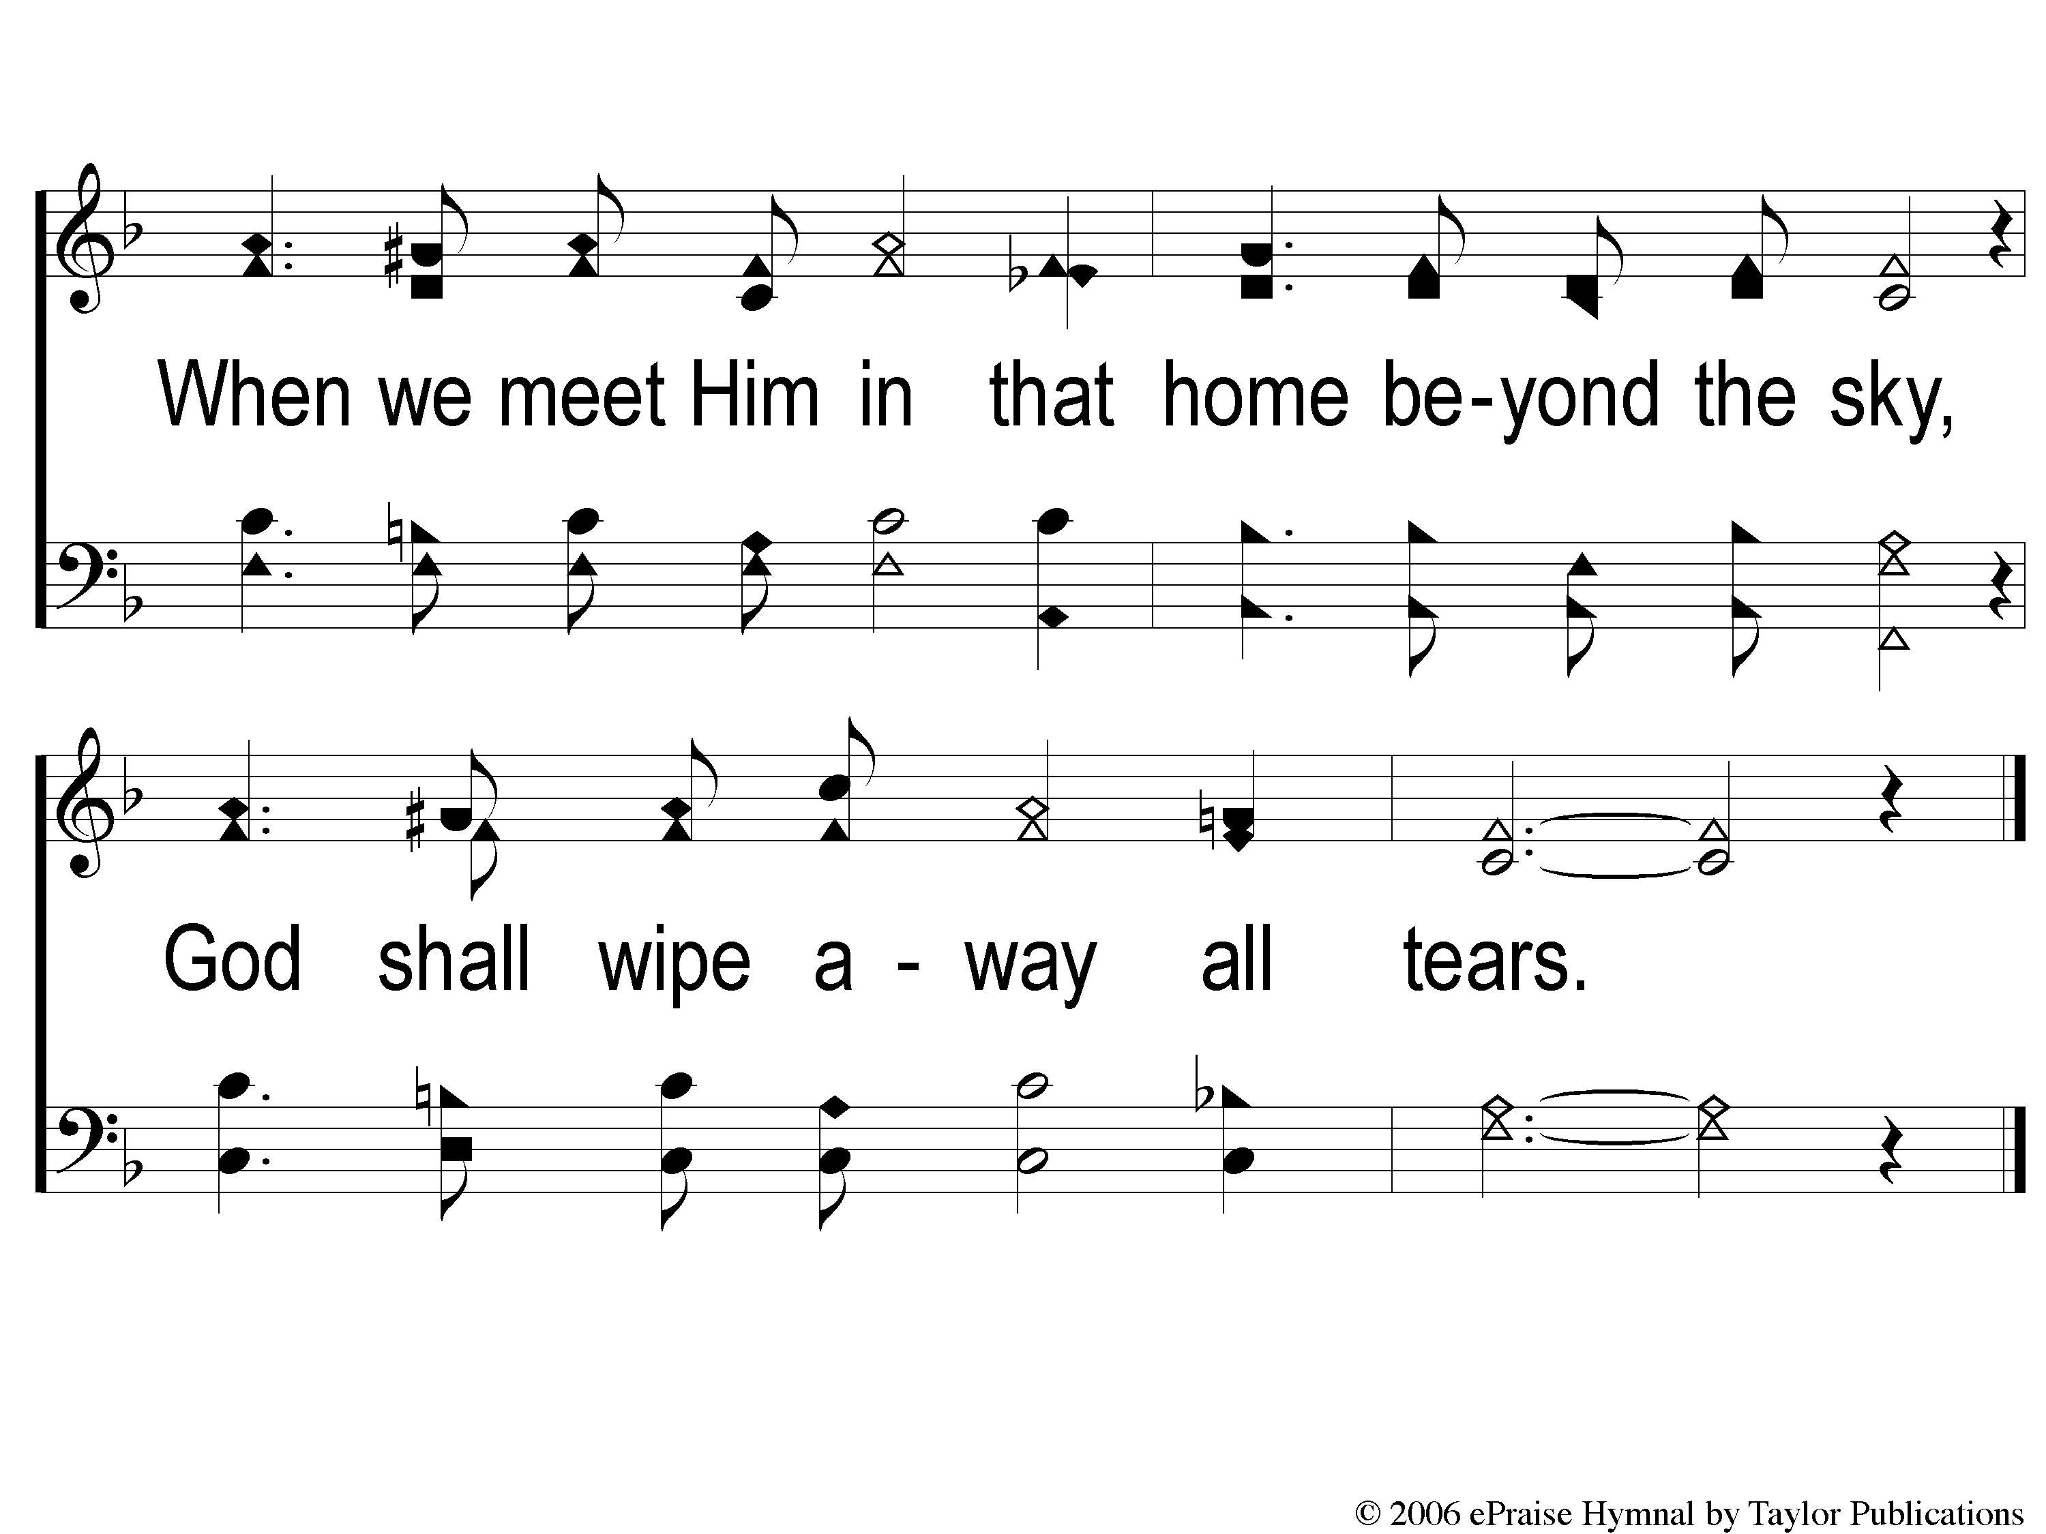
C-2 God Shall Wipe Away
God Shall Wipe Away
136

Slide 5
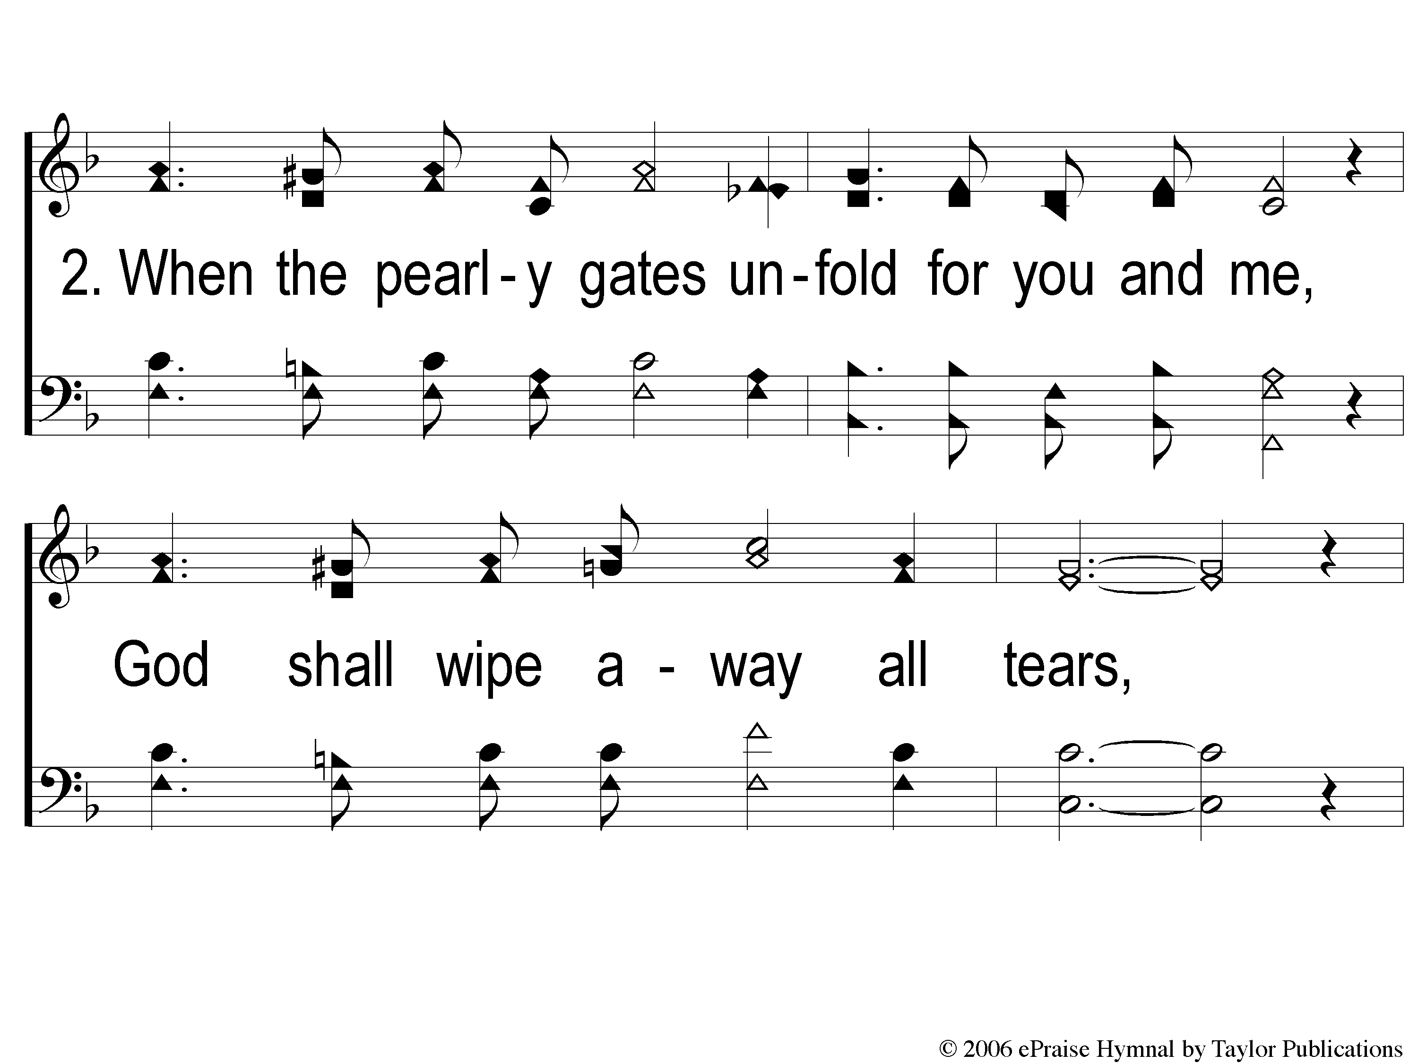
2-1 God Shall Wipe Away
God Shall Wipe Away
136

Slide 6
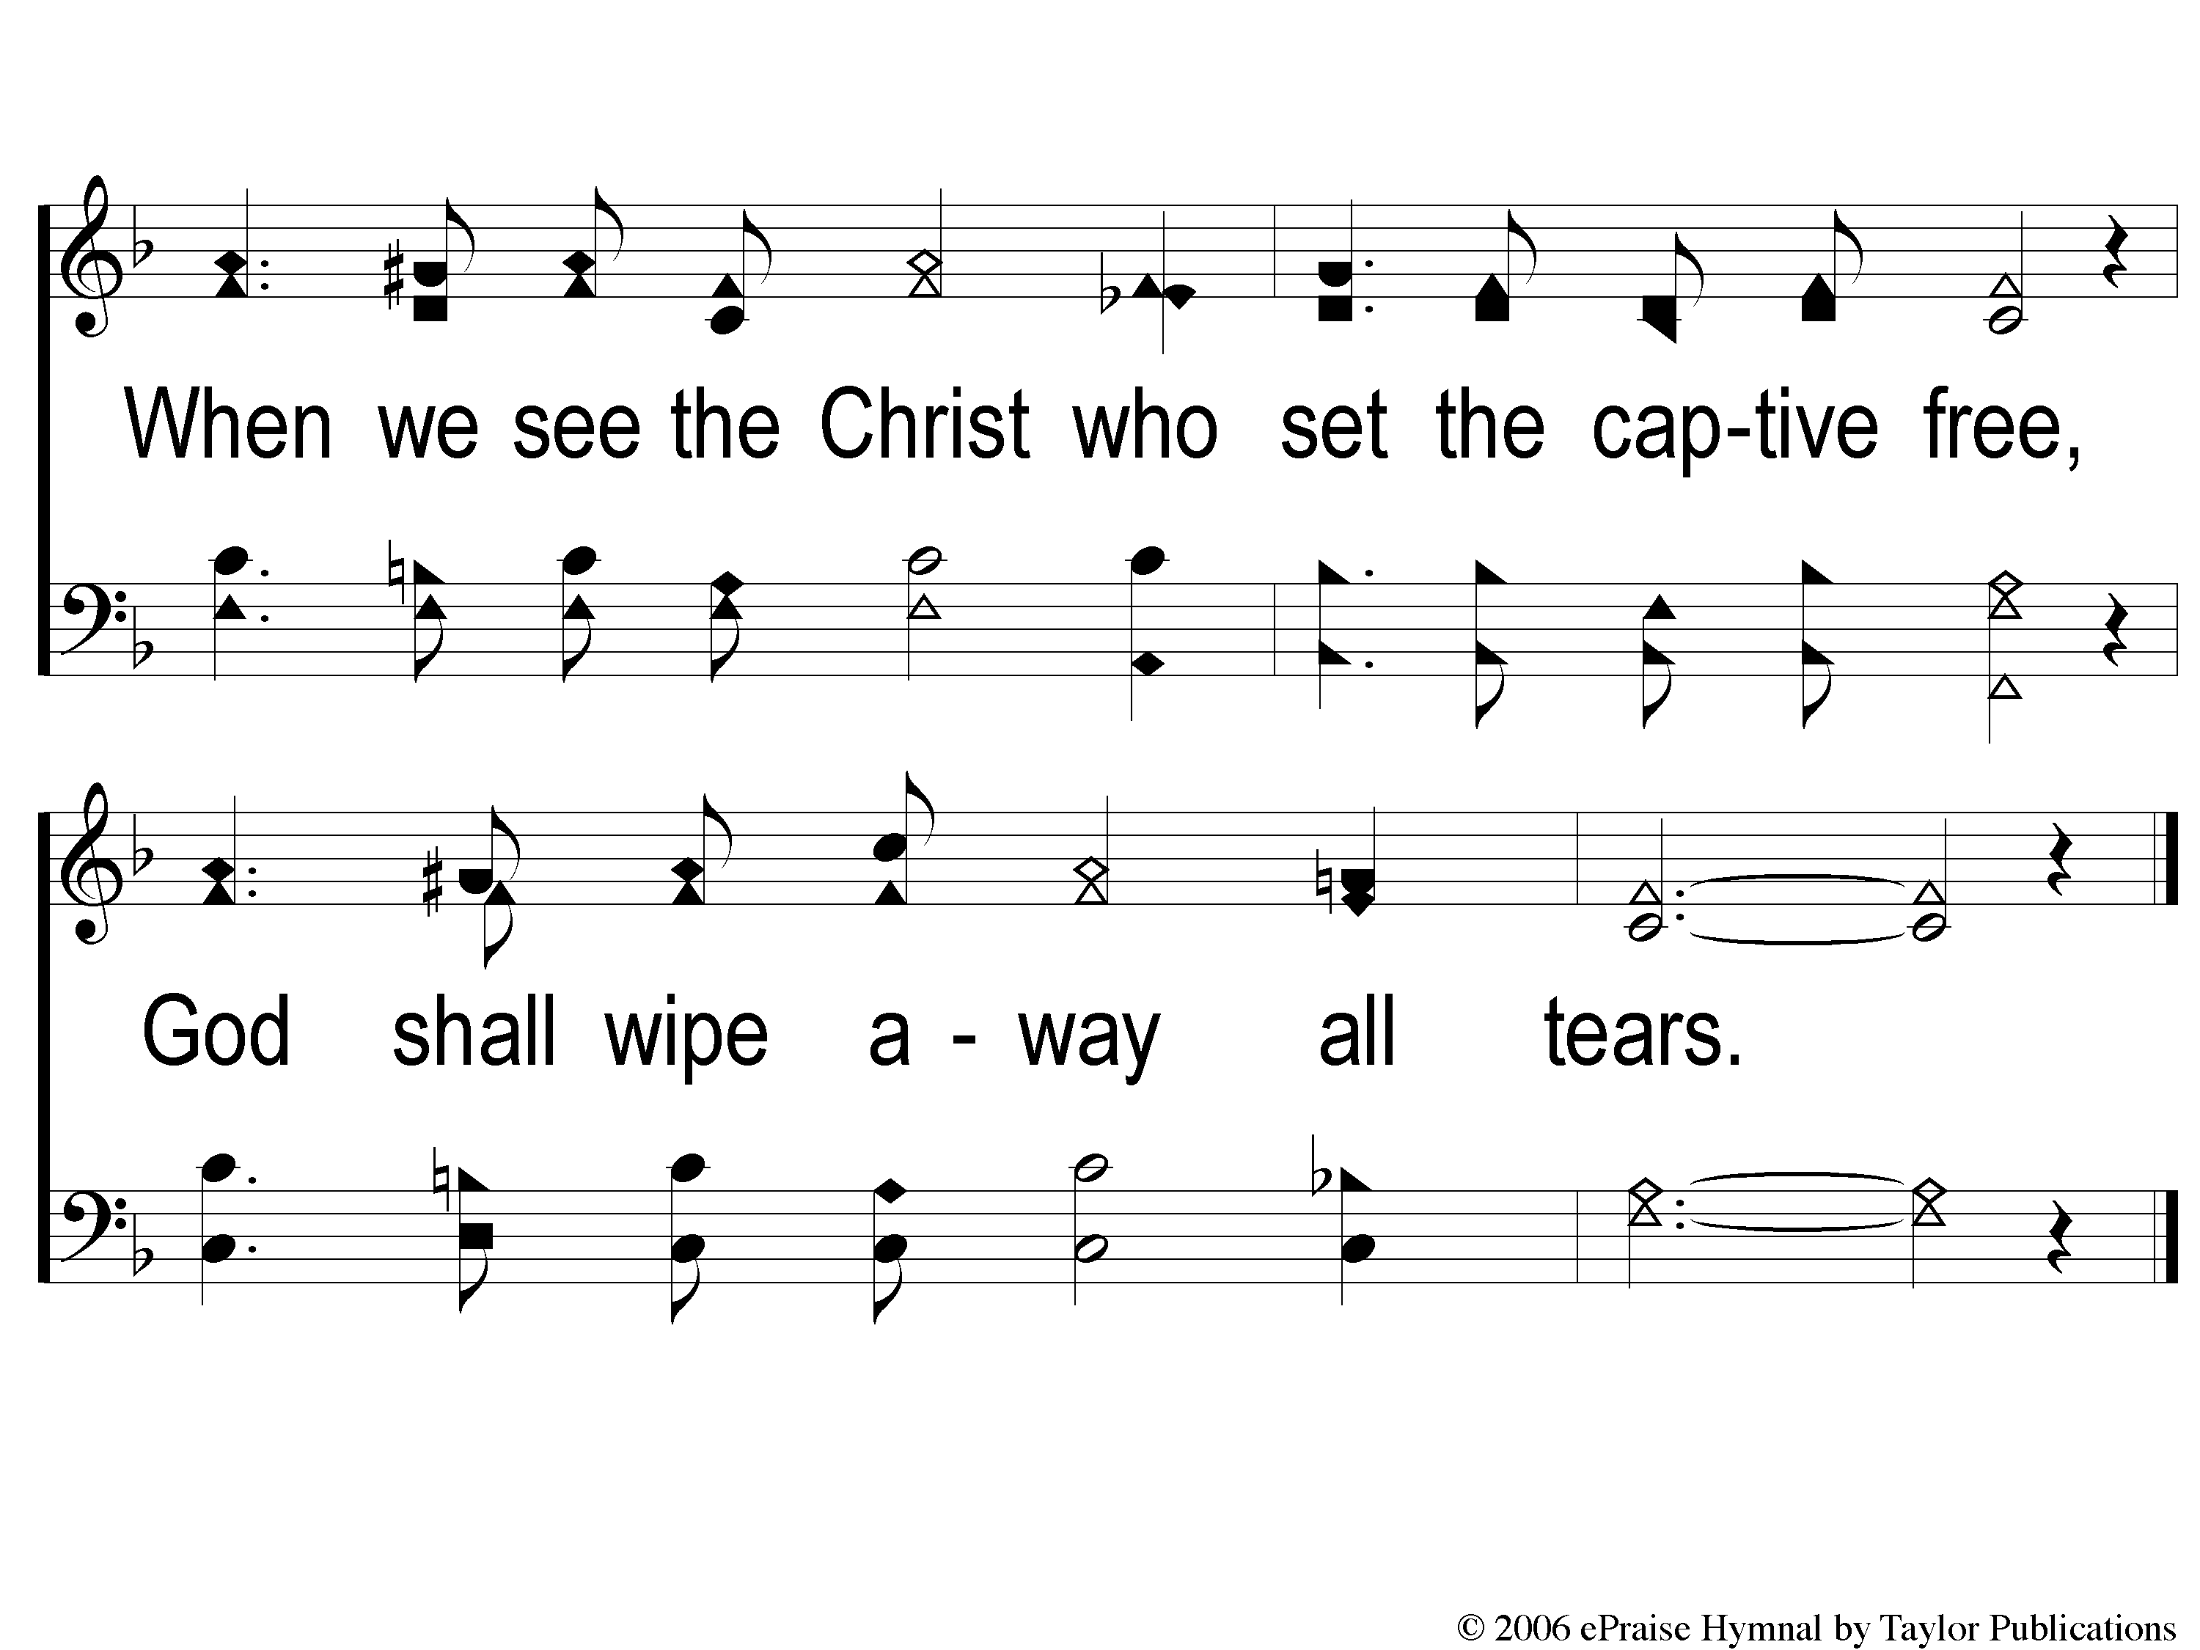
2-2 God Shall Wipe Away
God Shall Wipe Away
136

Slide 7
C-1 God Shall Wipe Away
God Shall Wipe Away
136

Slide 8
C-2 God Shall Wipe Away
God Shall Wipe Away
136

Slide 9
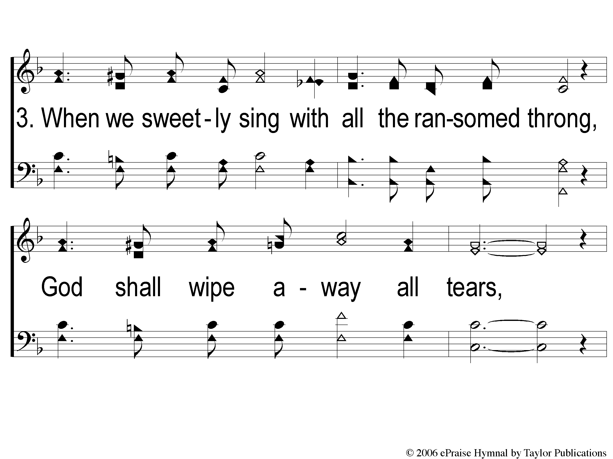
3-1 God Shall Wipe Away
God Shall Wipe Away
136

Slide 10
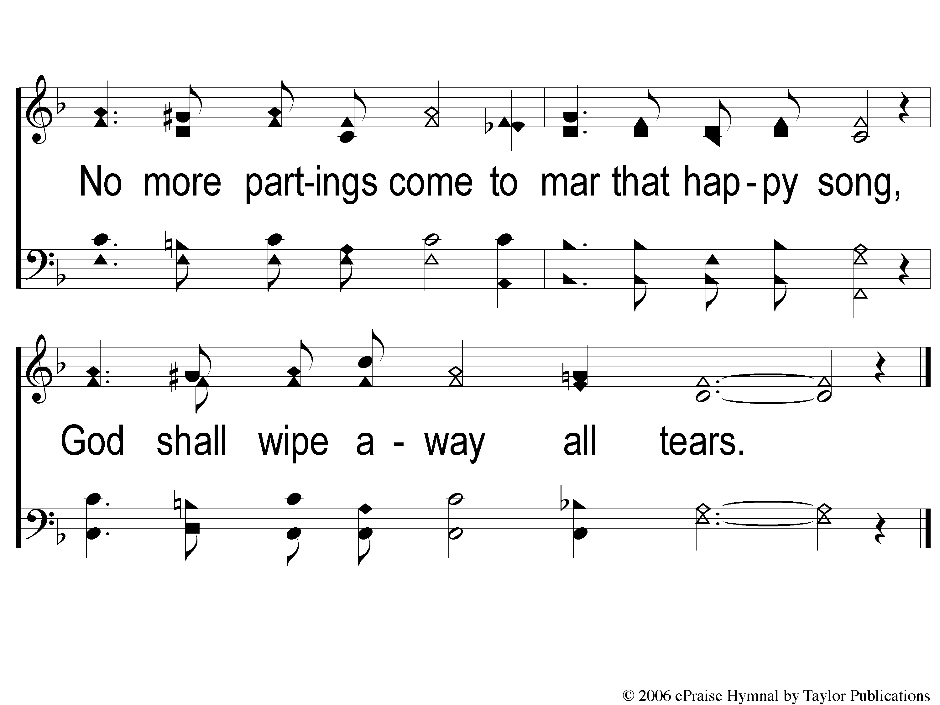
3-2 God Shall Wipe Away
God Shall Wipe Away
136

Slide 11
C-1 God Shall Wipe Away
God Shall Wipe Away
136

Slide 12
C-2 God Shall Wipe Away
God Shall Wipe Away
136

